Slide 1






Lecture #0
MGNM580

Slide 2


A COURSE: MACRO STRUCTURE
What?
Course Design
Why
How?
IPs
Design
Delivery
Course
Lecture
#0

Slide 3


COURSE DETAILS
MICROSOFT EXCEL: DATA ANALYSIS&BUSINESS MODEL by L. WINSTON WAYNE, PEARSON
BUSINESS DATA ANALYSIS USING EXCEL by DAVID WHIGHAM, OXFORD UNIVERSITY PRESS

Slide 4
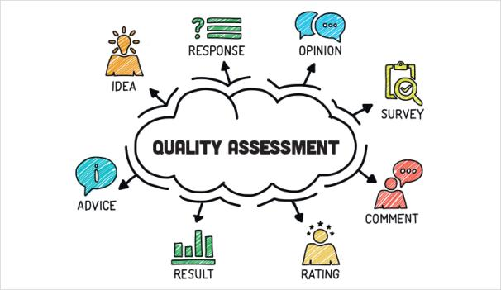
COURSE ASSESSMENT MODEL
Attenance 5
CA 45
ETE 50
Total 100

Slide 5

Unit I
Basic spreadsheet functions : basic functions and utilities, text functions, sorting and filtering data, graphs
Unit II
Elementary modelling I : if statement analysis, countif, countifs, sumif, sumifs, conditional formatting
Unit III
Elementary modelling II : lookup functions, pivot table and its applications, filter data using slicers in multiple pivot table, dashboard: visualize aggregate data using pivot table
Unit IV
Sensitivity analysis : goal seek, data table, scenario analysis
Unit V
Macros : recording macros, running macros, use relative references in macros, deleting recorded macros
Unit VI
VBA macros programming : create and record macro in spreadsheet, msgbox, declaring variables, writing a subroutine and function in vba, if then statement, case statement, for loop, while loop anddo until, worksheet and range object

Slide 6
COURSE OUTCOMES
CO1 :: demonstrate the principles of a good spreadsheet design and effectively present the analysis and results.
CO2 :: obtain basic knowledge of commonly used analytic tools in processing quantitative information and making quantitative business decisions.
CO3 :: analyze data using excel functions and various data management tools in order to gain greater insights to key business drivers.
CO4 :: develop robust and dynamic models that automatically change through the use of text, date and time functions.
CO5 :: develop VBA spreadsheet based solutions to financial problems.
CO6 :: apply macros for automating tasks in spreadsheet for efficient decisions and effectively present the analysis and results.

Slide 7
PROGRAM OUTCOME MAPPING WITH MGNM580
PO1: Developing responsiveness to contextual social issues and exploring solutions in the light of social and business ethics.
PO2 : Apply research tools for analytical decision making and problem solving using cross functional information.
PO3: Demonstrate global outlook with ability to identify challenges and opportunities in view of Cross-Cultural Understanding
PO4: Leveraging domain knowledge for organizing information, analysis and exploring business opportunities
PO6: Demonstrate proactive leadership and building effective teams to handle challenging assignments.
PO7: Evaluate and execute ideas for entrepreneurship while taking calculated risks.
PO8: Leverage technology for efficient and effective functioning through information sharing and collaboration.

Slide 8
VISION & MISSION
Vision
To be a premier academic institution, recognized internationally for its contribution to industry and society through excellence in teaching, learning, research, internationalization, entrepreneurship and leadership.
Mission
To transform education through academic rigour, practical orientation and outcome based teaching.
To develop and implement a relationship of cooperation between industry and academia.
To undertake impactful research addressing local, national and global challenges.
To prepare graduates to be lifelong learners with strong analytical and leadership skills.
To develop global professionals and entrepreneurs with innovative spirit, tolerance and desire to make a difference to the society.

Slide 9
PRE REQUISITES
Basic knowledge of Excel
Basic knowledge of Accounting
Basic knowledge of Financial Management
Basic knowledge of SAPM

Slide 10



BRAINSTORM

Slide 11
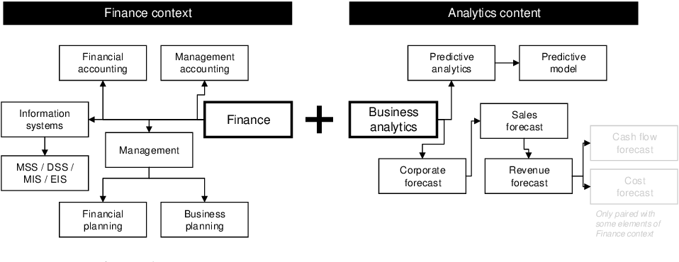


Slide 12
CAREER PROSPECTS
Financial Analyst:
  Equity
  Merger and Acquisition
  Corporate Taxation
  Projections
  Corporate Valuation
  Consultancy
  Personal Financial Planning
  Corporate Financial Planning

Slide 13
SKILL SET
Data Analysis
Quantitative Analysis
Number Crunching
Forensic Audit
Financial Accuracy

Slide 14
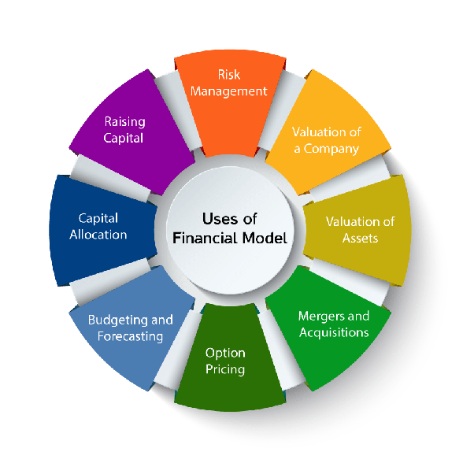

EXCEL MODELLING

Slide 15
ONLINE COURSES AND EXTERNAL CERTIFICATIONS
Certification in Excel Modeling
https://www.udemy.com/course/beginner-to-pro-in-excel-financial-modeling-and-valuation/
https://www.linkedin.com/learning/excel-essential-training-microsoft-365-17231101/applying-numeric-formats?autoplay=true&u=104956452
Financial Modeling Certification by IMS Pro-School
  http://www.proschoolonline.com/financial-modeling-course

Slide 16

ACADEMIC TASKS
Test will be taken from topics i.e. Basic spreadsheet functions, Elementary Modelling I, Text Functions, IF/Nested if statement analysis, CountIf, Sumif and Conditional formatting and student will be evaluated on the basis of execution in the class.
Question will be analytical so that students can execute the questions in the Microsoft excel
Test will be of 45 minutes and 3 questions will be there for 10 marks each

Slide 17
ACADEMIC TASKS
Test will be taken from topics i.e. Elementary Modelling II, Sensitivity analysis and Macros Question will be analytical so that students can execute the questions in the Microsoft excel
Question will be analytical so that students can execute the questions in the Microsoft excel
Test will be of 45 minutes and 3 questions will be there for 10 marks each

Slide 18
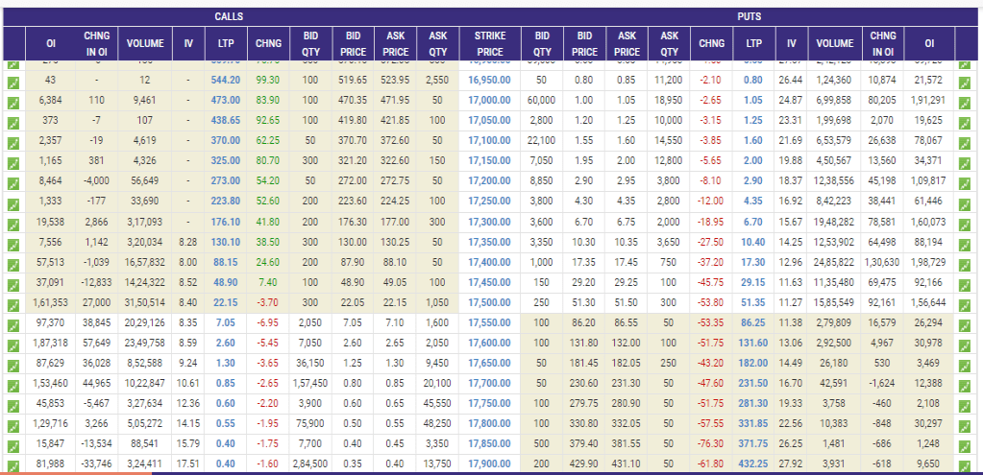

Slide 19
Introduction to Spreadsheets
Microsoft Excel 2010/2016 is the spreadsheet program in Microsoft Office
2010/2016.
A spreadsheet is a grid of rows and columns in which users enter text,
numbers, and the results of calculations.
In Excel, a computerized spreadsheet is called a worksheet.
The file used to store worksheets is called a workbook.
Each workbook contains three worksheets by default.
displayed in the work area is the active worksheet.
The worksheet

Slide 20
Rows and Columns – Excel 2010
Rows 1048576 ( 1 to 1048576)
Columns 16384 (A to XFD)

Slide 21

ISSUES IN SPREADSHEET MODELLING
Issues of the New Millennium
The effect of changing technology
The globalization of business

Slide 22

HOW SPREADSHEET MODELLING IS USED IN PERSONAL FINANCE
HOW DATA ANALYTICS IS BEING USED TO SIMPLIFY PERSONAL FINANCE FOR CONSUMERS
New product design
Anticipate customer preferences, and
Increase profitability
Data-Driven Portfolios Simplify Investing
AI-Based Recommendation Tools Lead to Smarter Decision-Making
Personalized Offers Increase Conversion Rates
https://www.analyticsinsight.net/how-data-analytics-is-being-used-to-simplify-personal-finance-for-consumers/

Slide 23

QUIZ
The 3 Ps, i.e. the three objectives of analysis and interpretation of financial statements are
Progress, Position and Positivity.
Progress, Position and Prospects.
Progress, Position and Precision.

Slide 24

QUIZ
Which of the following statements about the primary purpose of financial reporting is the most correct?
A Provides information that can help with decision making.
B The individual needs of users can be satisfied by tailoring of financial reports.
C Enables accountability since managers would have to account for resources used.
D Identifies a range of existing and potential users dependant on financial statements to make decisions.

Slide 25

QUIZ
Which of the following would not be an example of a user who may rely on general purpose financial reports?
A Henry who is given $5 000 on his 18th birthday by his grandfather to invest in the share market.
B Singh who manufactures sugar free muesli bars hopes to secure long term sales contracts with school anteens all over the county.
C Milly who runs a successful organic food café is keen to expand into the food truck industry by obtaining finance via crowd-funding.
D Van who owns a fishing and camping store is keen to expand his product range by approaching his suppliers to ask about increasing his credit limit.

Slide 26

QUIZ
The accountant of Scrub and Shine Ltd identified an aggregate charge of $500 000 (comprising 126 various supplier invoices) of advertising expense for a new microfibre cloth within the entity’s financial records. Should the accountant present this item separately in the financial statements?
A Yes, the aggregate value of this advertising expenditure is material.
B Yes, details of all transactions should be disclosed to assist users make fully informed decisions.
C Possibly. This would depend on the size and nature of the advertising expenditure relative to other items disclosed in the financial report.
D No, the individual values of the invoices comprising this amount are immaterial. The disclosure requirements do not apply to immaterial items.

Slide 27

QUIZ
Which of the following statements about enhancing qualitative characteristics of financial statements is not correct?
A Fair values of assets that cannot be verified in an active market should not be disclosed in the financial statements.
B The financial statements of similar entities adopting different asset measurement bases can be adequately compared.
C The value of invoices not yet received from suppliers for services should be estimated at financial year end for reporting purposes.
D Financial statements should be presented with the assumption that a reasonable and informed third person will know how to analyse financial information.

Slide 28







LECTURE DELIVERY

Slide 29



